Slide 1
AI-in-One: Storyboard

Slide 2
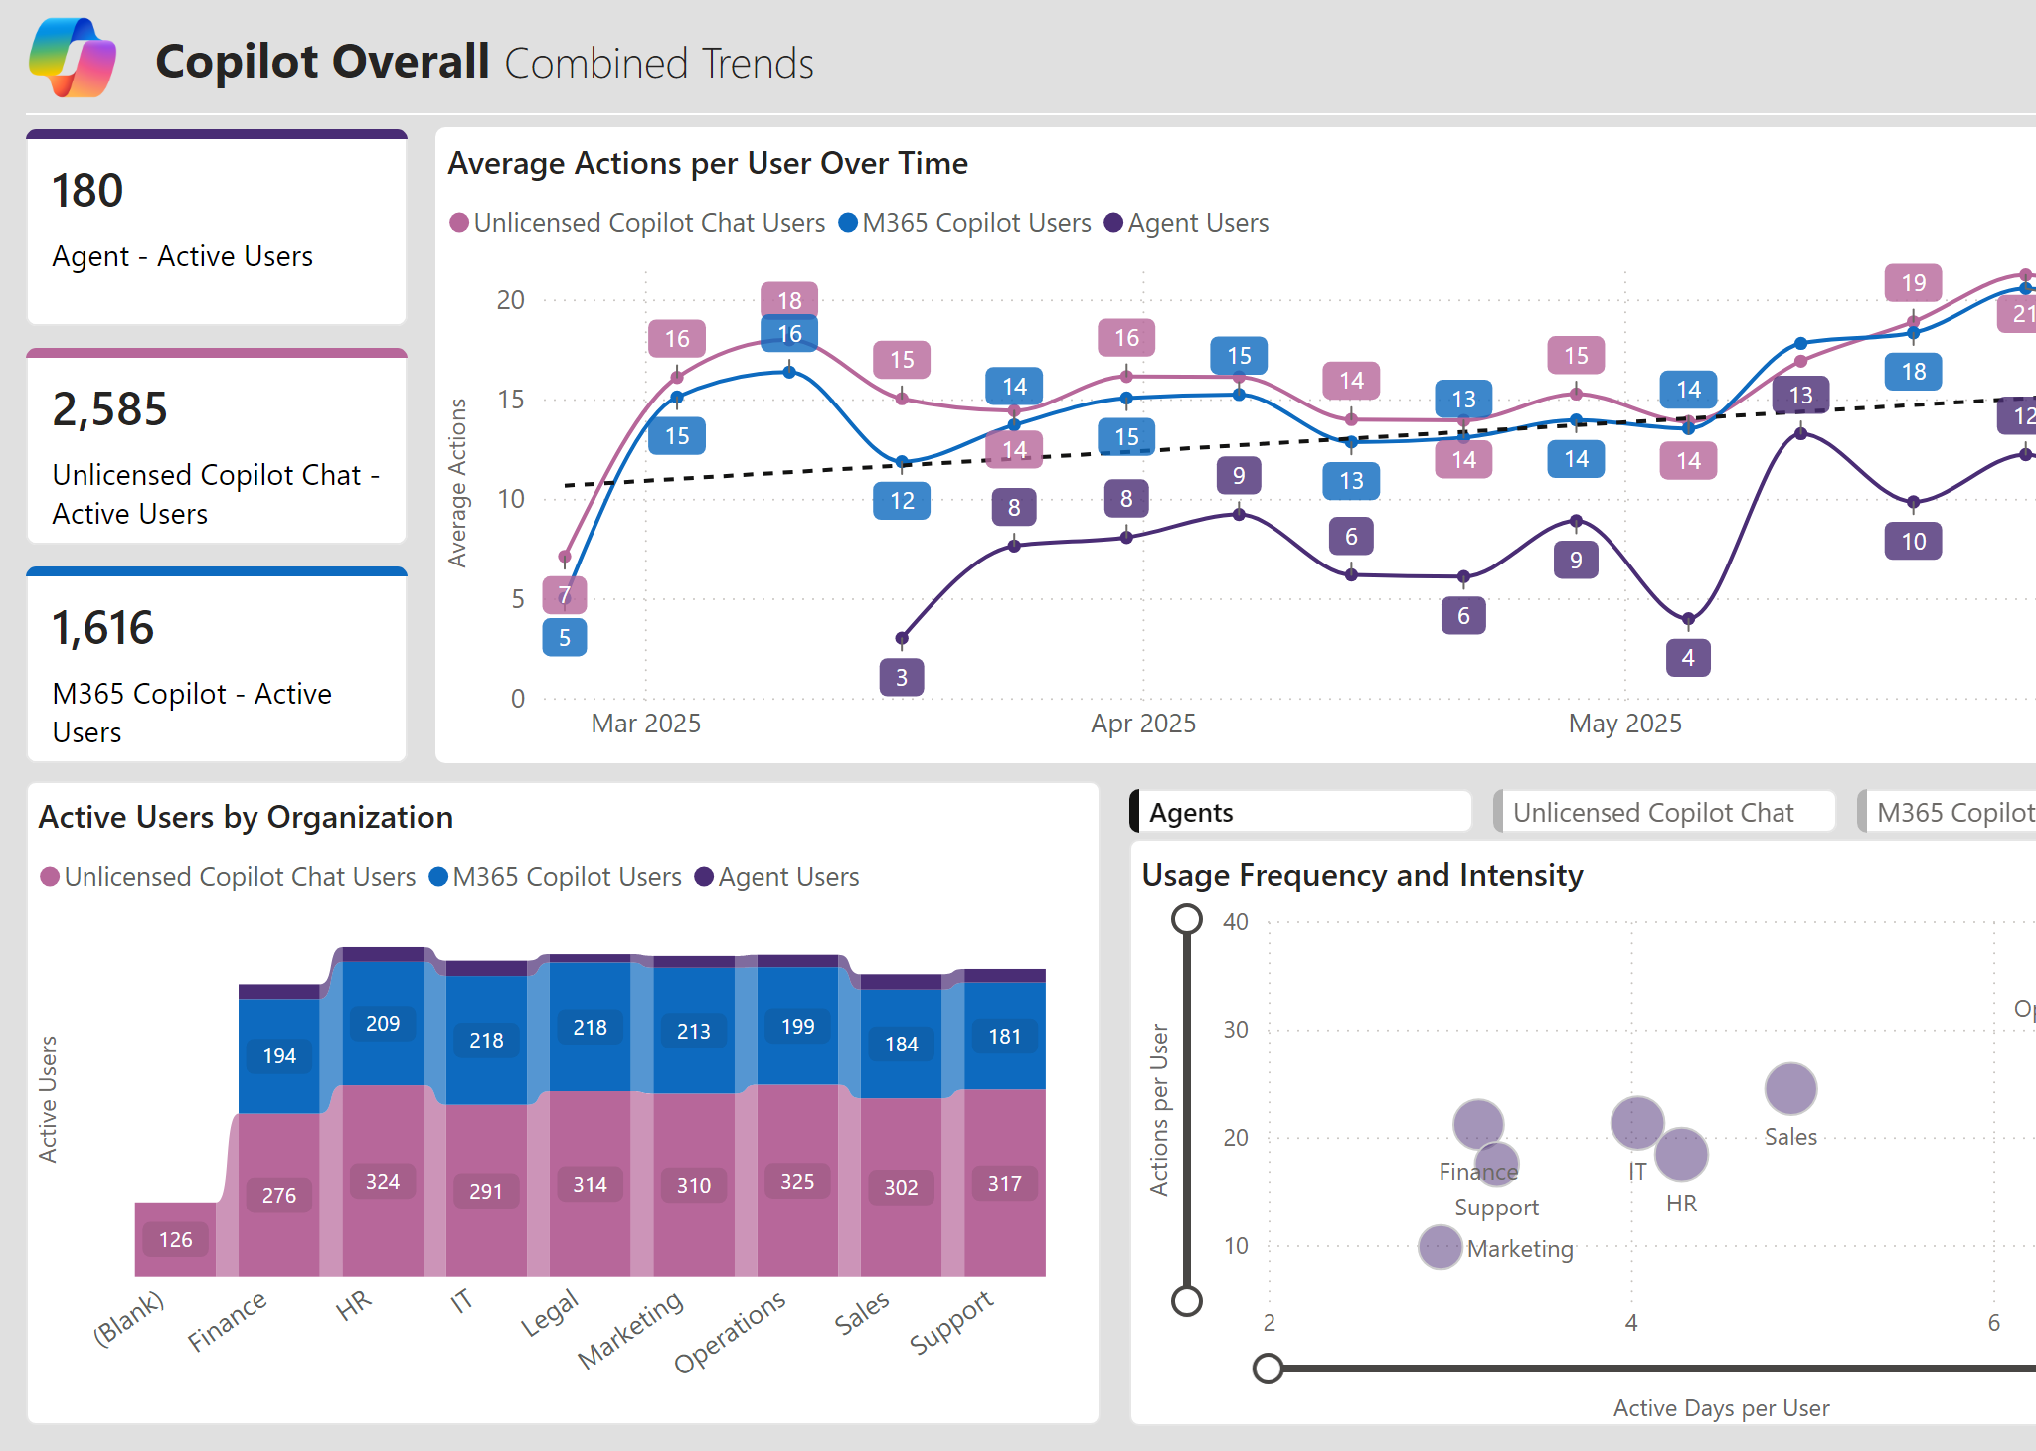
The Funnel Is Real: Chat → Copilot → Agents
Example visual
What it means
Bottom-up pull is strongest in Chat; it’s the top-of-funnel signal for demand and use-case discovery.
Engagement varies by function, revealing where near-term business value will materialize first.
Different products map to different jobs: quick assist in Chat, deeper assist in Copilot, repeatable workflows in Agents.

Slide 3
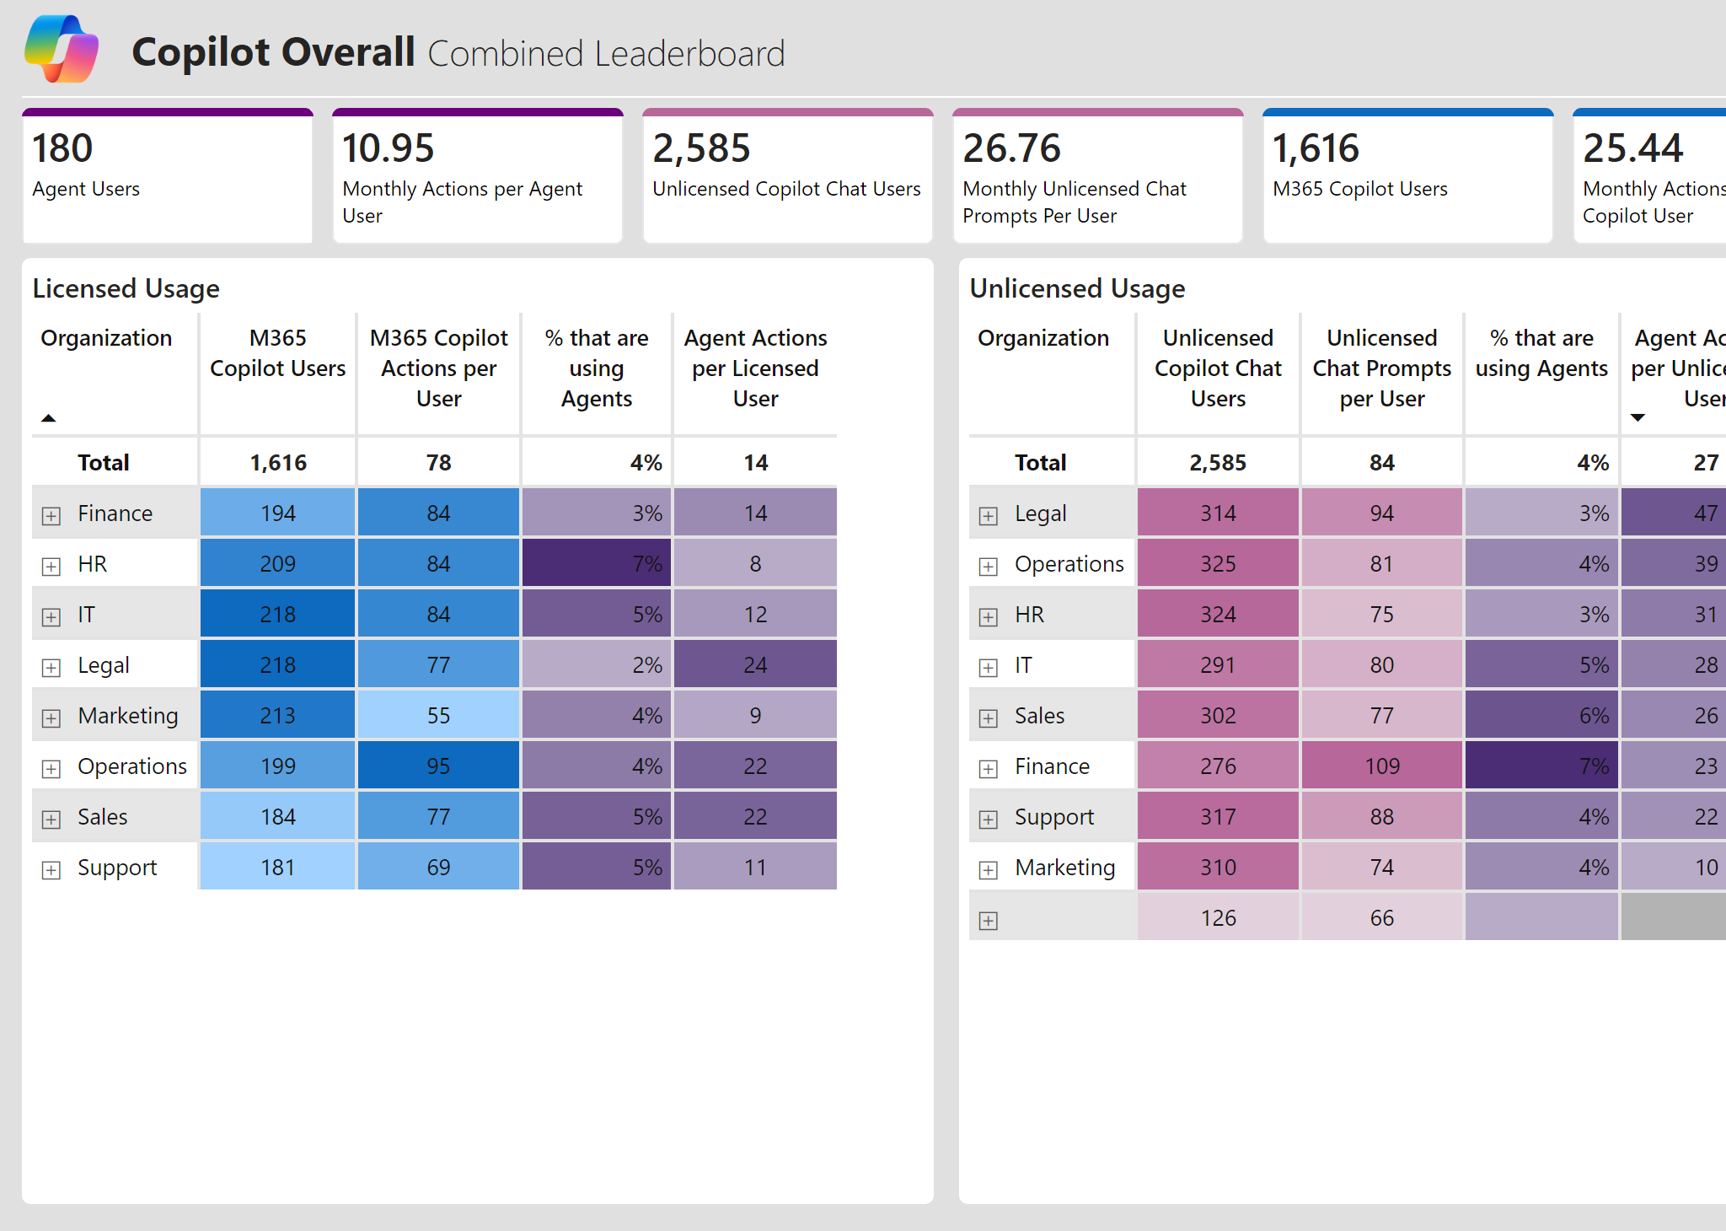
One View to Orchestrate: Licensed + Unlicensed + Agents
Example visual
What it means
M365 Copilot licensed users show a higher usage of Agents across the board.
On the unlicensed front, Operations/IT/Finance/Legal show the highest readiness for M365 Copilot. Their unlicensed prompts as well as agent activity mirror their licensed counterparts

Slide 4
Agents

Slide 5
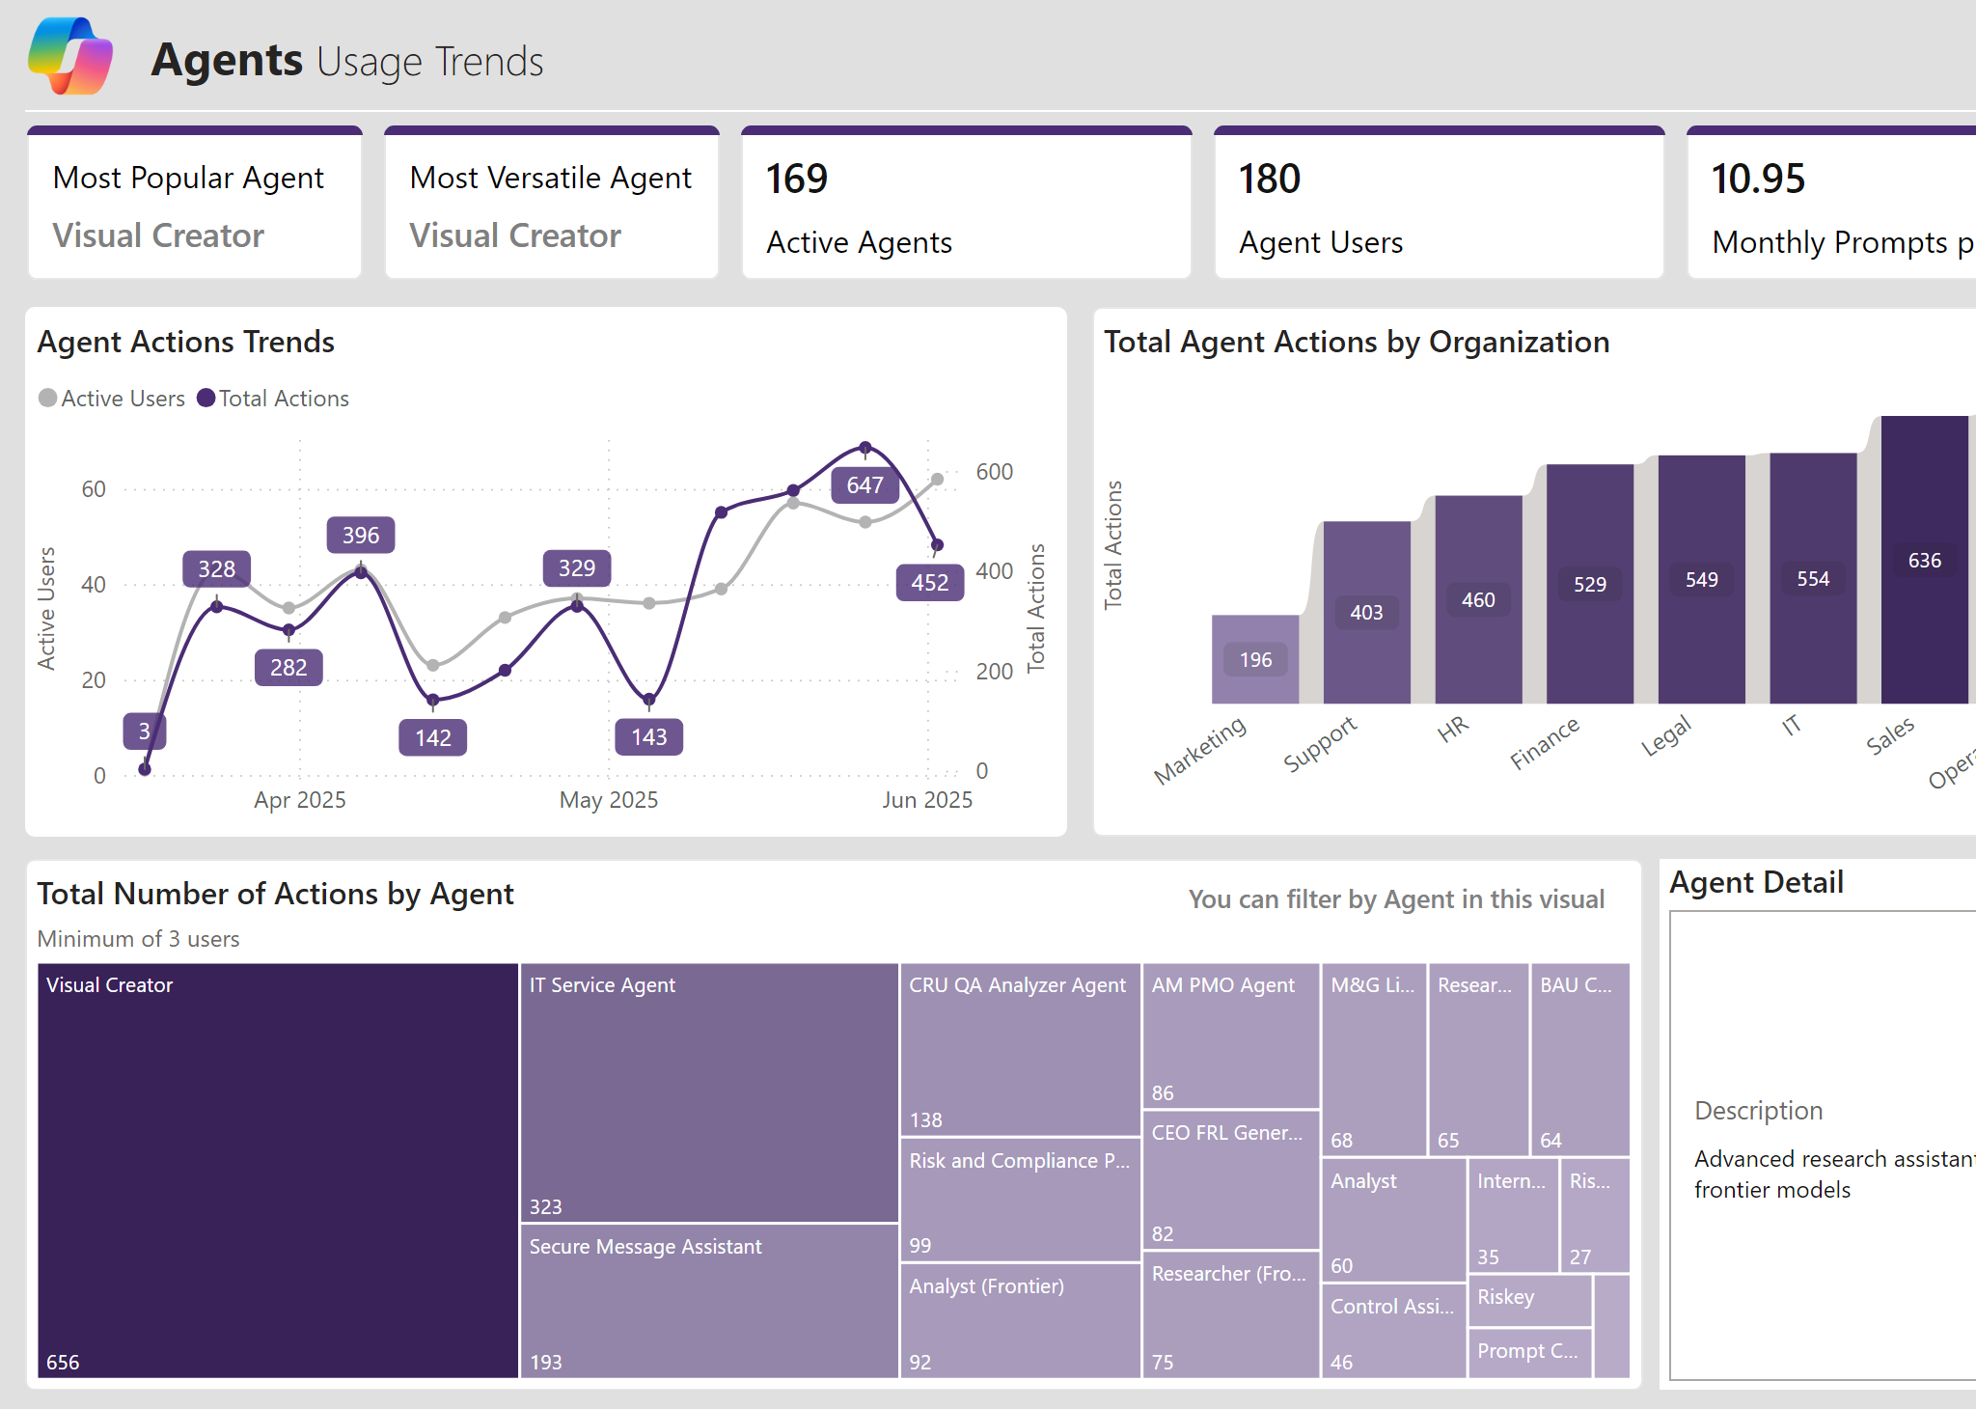
The Agent Pattern: Few Hits, Clear Workhorses
Example visual
What it means
A small set of agents carry outsized usage
Agent activity and agent users are both rising with ____ and ____ showing the highest traction.

Slide 6
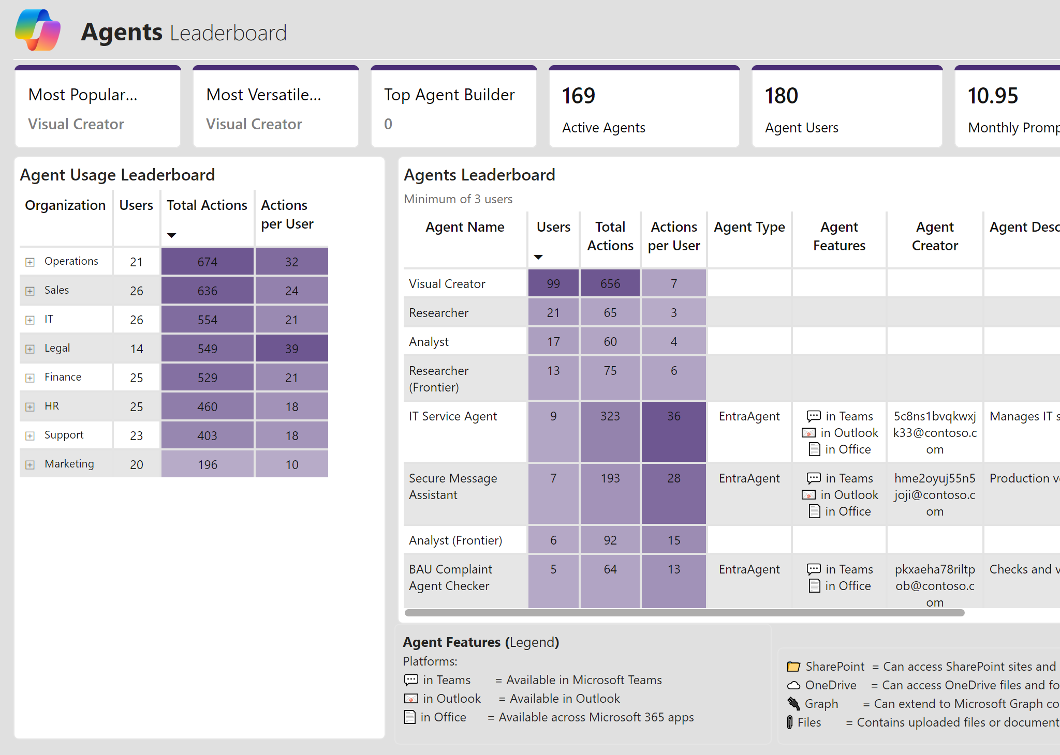
Where Agents Land: Function-Specific Intensity
Example visual
What it means
____, ____, _____ built by Microsoft have the highest users
Custom agents _____, _____, _____have the highest intensity showing a clear fit with workflow
Agents placed within Teams and Outlook show highest usage intensity (actions per user).

Slide 7
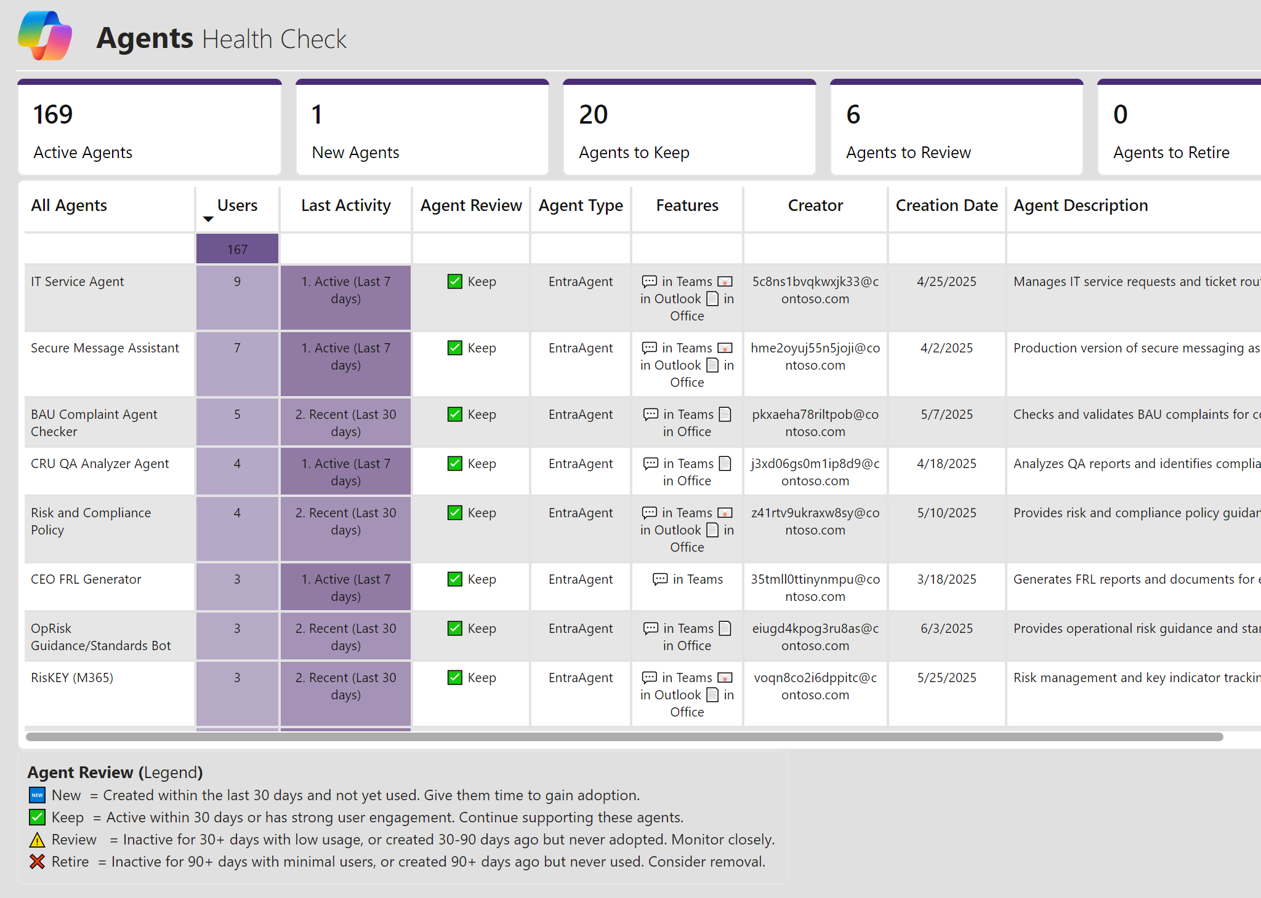
Portfolio Health: Govern to Grow
Example visual
What it means
___ agents are healthy; while ___ needs review.
___ agents have no activity and may need to be retired

Slide 8
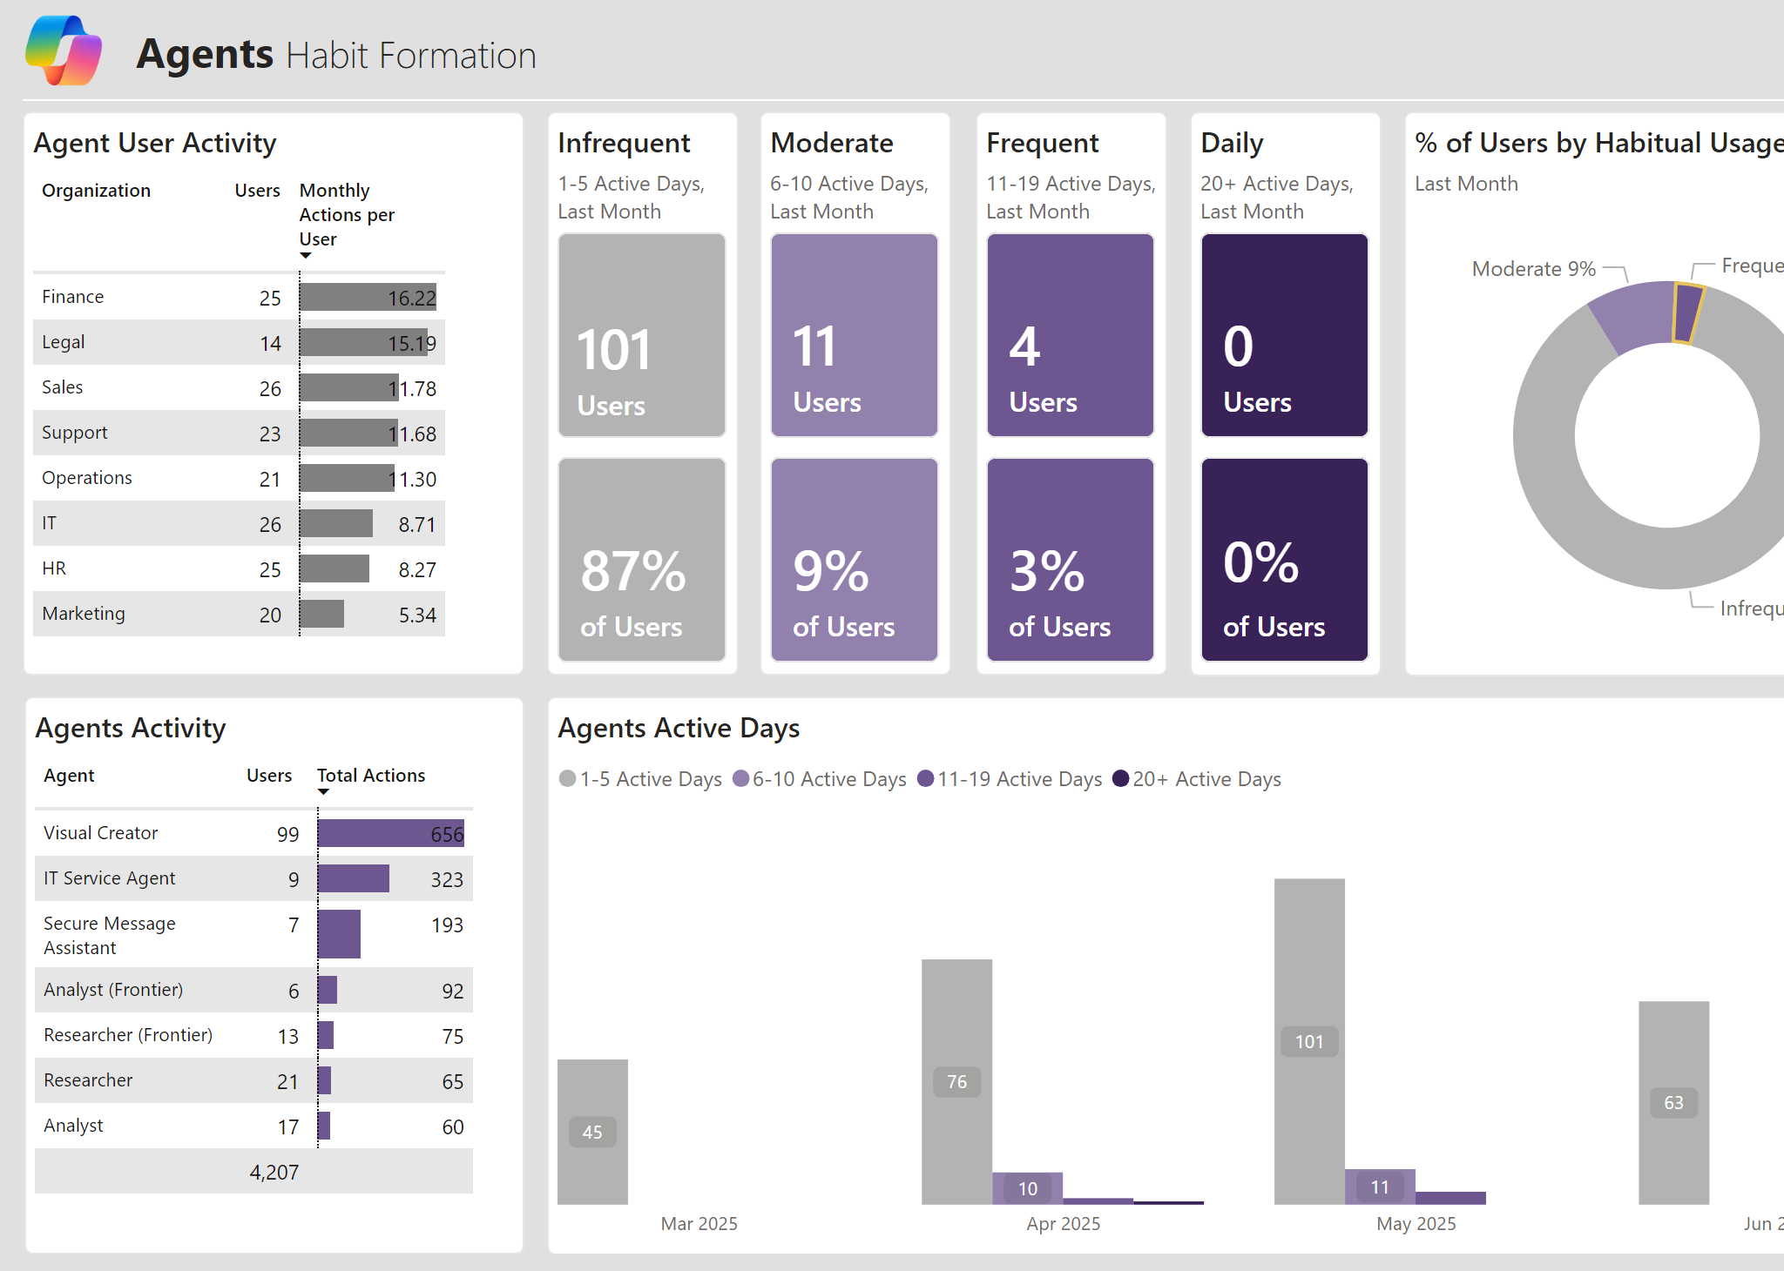
Agent Habits: Move Infrequent → Frequent
Example visual
What it means
Most users have moderate activity; a small power-user cohort drives disproportionate value—classic early adoption.
Function-level differences suggest targeted coaching can meaningfully lift habits.

Slide 9
Copilot Chat

Slide 10
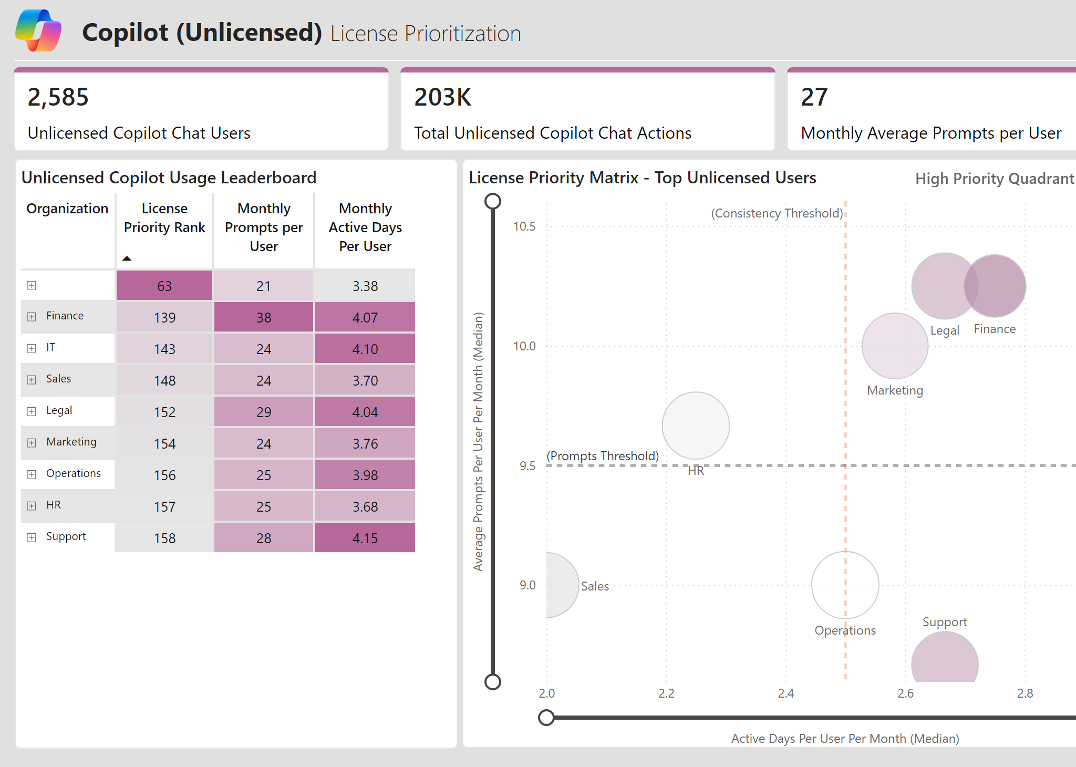
License Prioritization: Data-Led Conversion Engine
Example visual
What it means
High prompt volume + consistent active days identifies the highest-yield unlicensed users to convert.
Marketing, Legal, and Finance lead the way both in frequence and intensity and are priority cohorts for licensing
Sequencing licensing by function based on this grid creates a repeatable conversion motion.

Slide 11
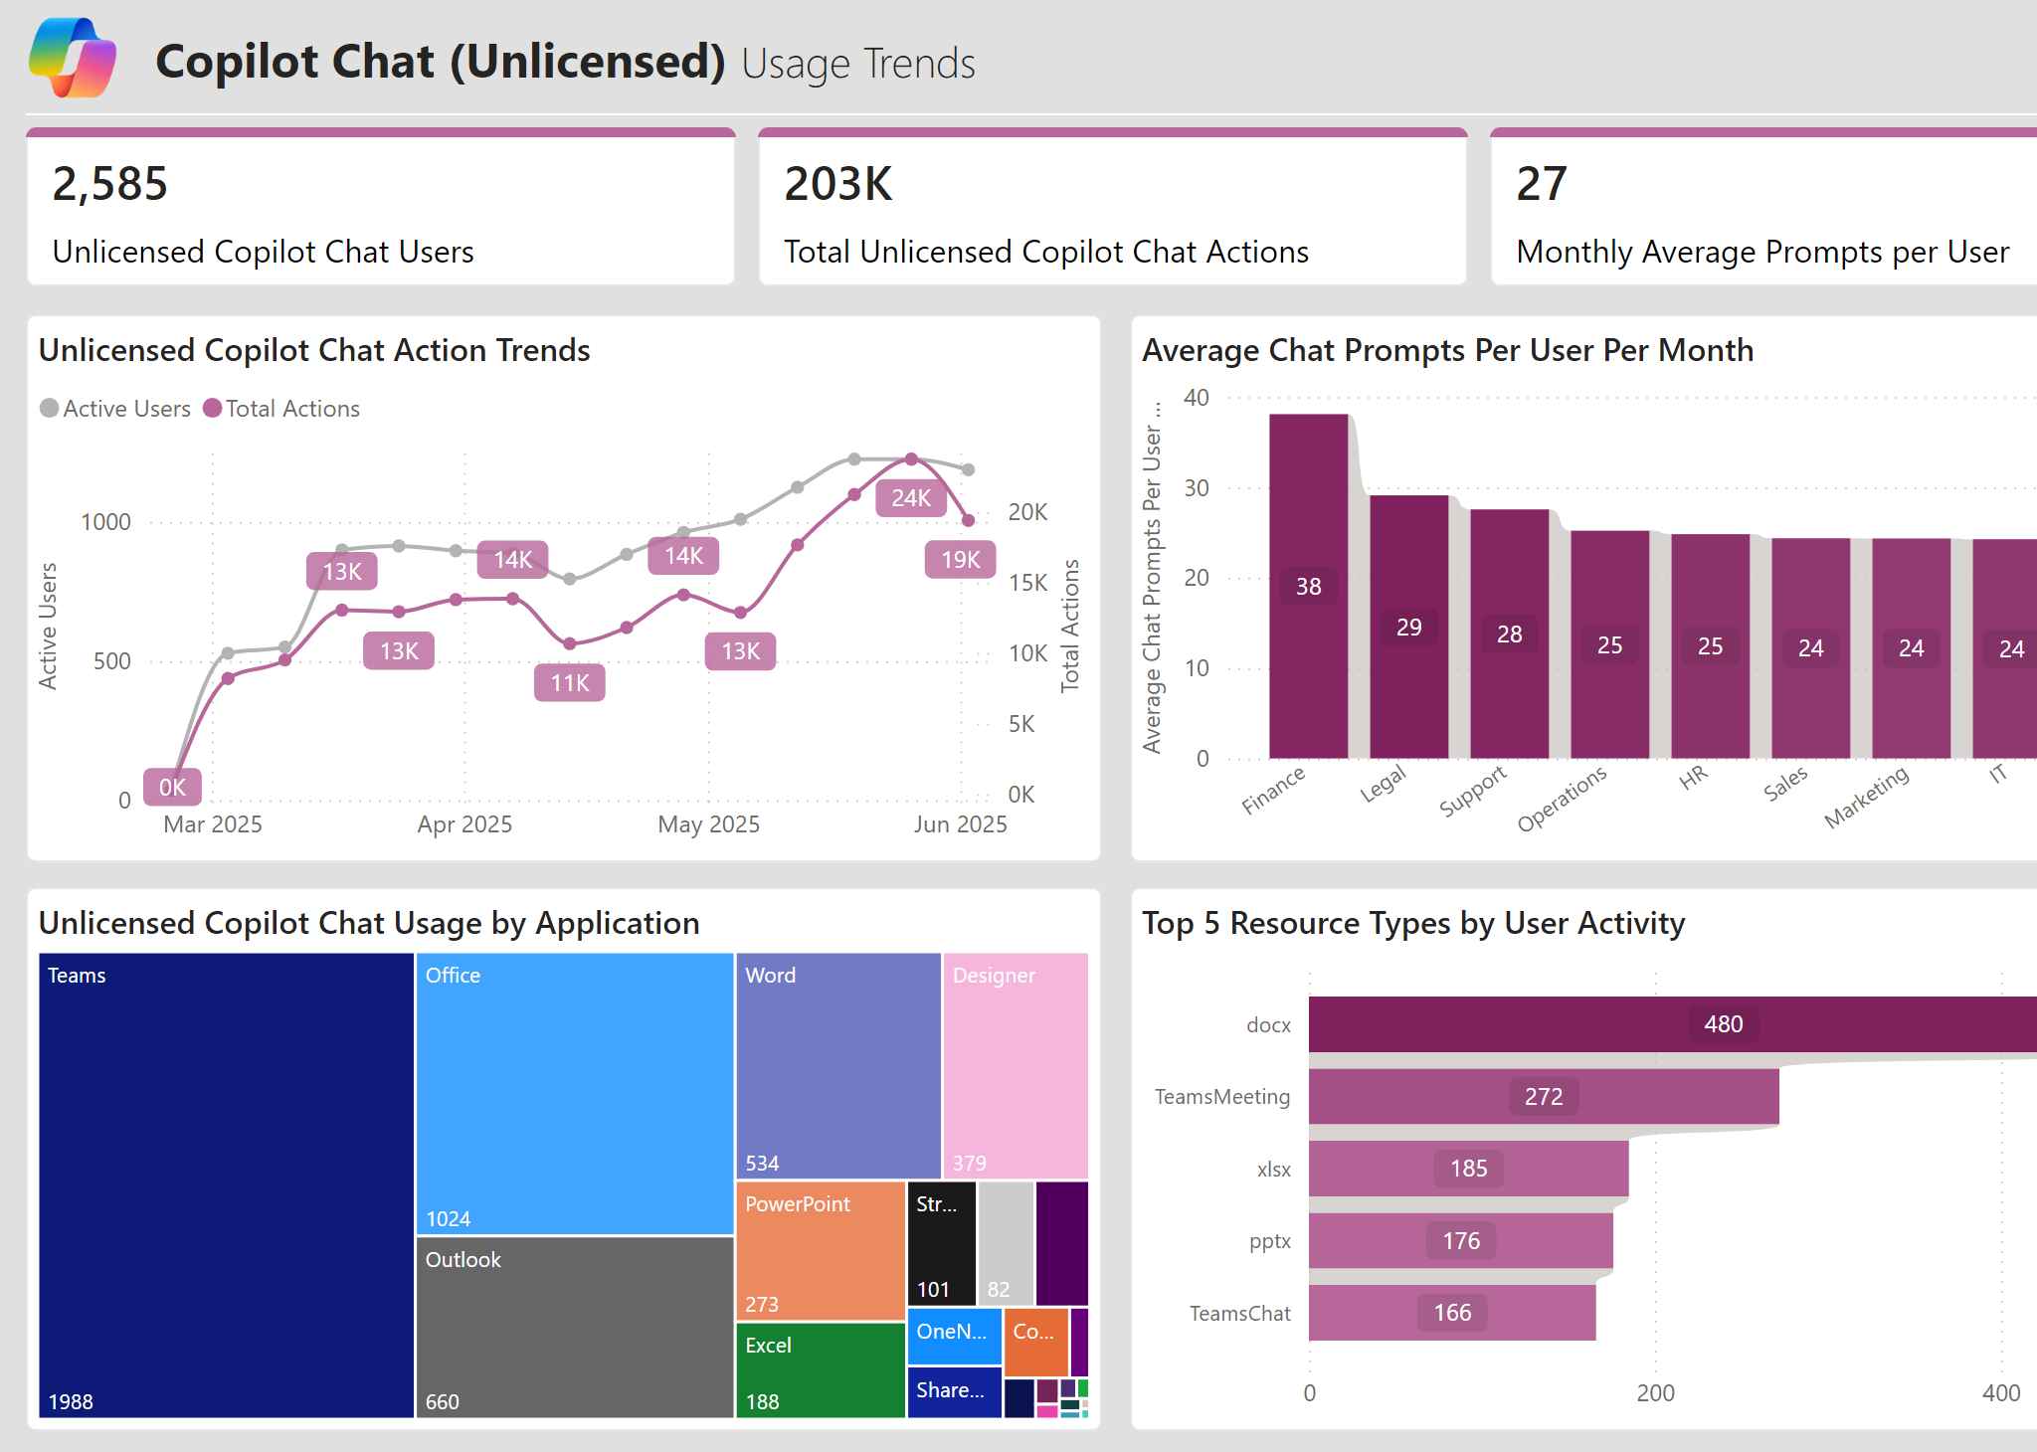
Where Chat Happens: Teams, Office, Documents & Meetings
Example visual
What it means
Teams and Office dominate unlicensed chat usage entry points, centered on documents and meeting workflows.
Word, pptx, and excel usage in chat further signal a need for enterprise solution
Finance shows a clear lead in usage of Chat

Slide 12
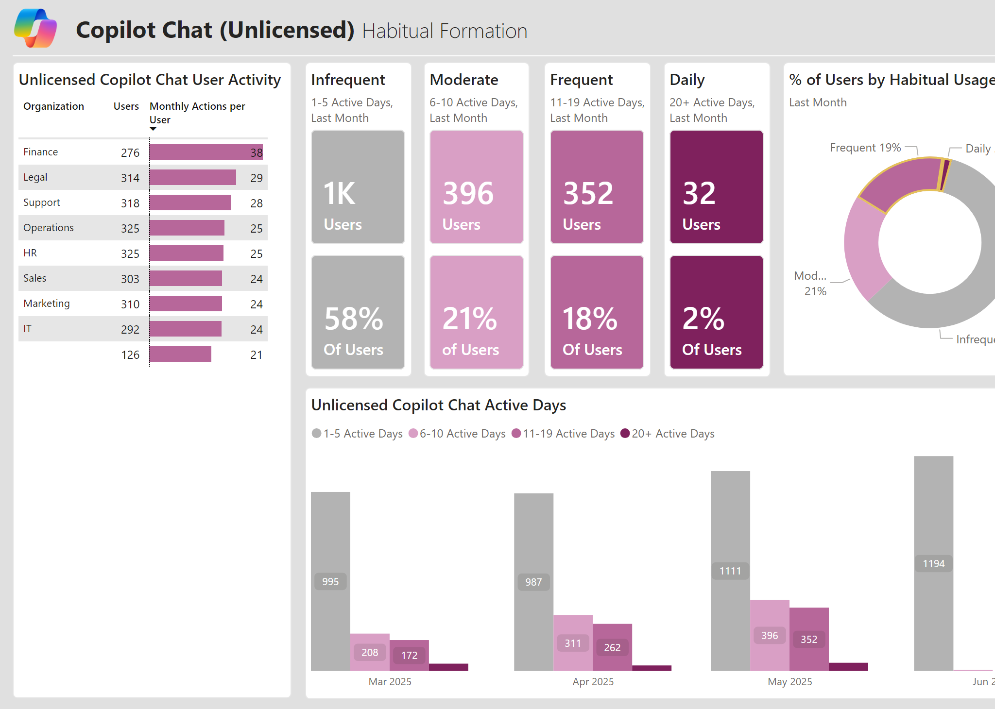
Chat Habit Formation: Many Are Close to Frequent
Example visual
What it means
20% of unlicensed users are high frequency users of Chat and are demonstrating clear readiness
21% are at the cusp of building habits and will soon be ready for licensing
Light coaching can shift many users one tier up in active days.

Slide 13
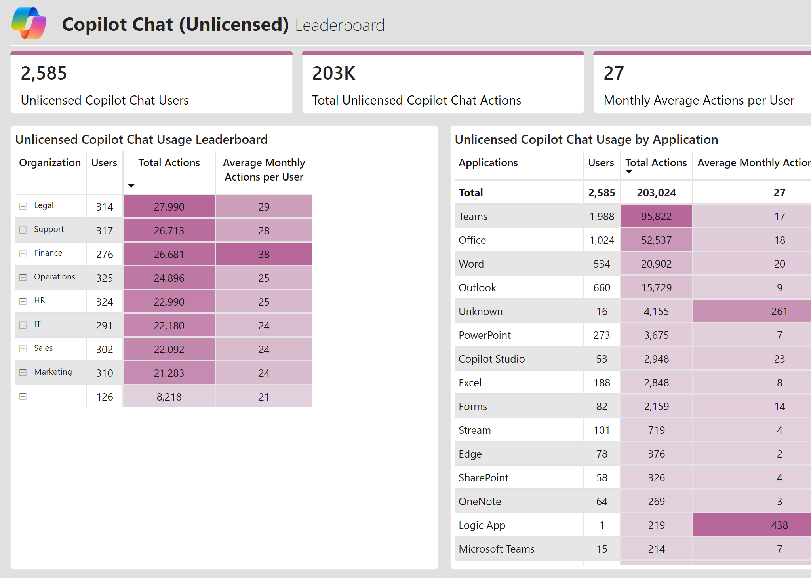
Long Tail of Apps, Short List of Winners
Example visual
What it means
We are seeing an average of 27 actions/month among unlicensed users compared to 48 actions in licensed user population
Teams and Outlook are the surfaces with highest users.

Slide 14
M365 Copilot

Slide 15
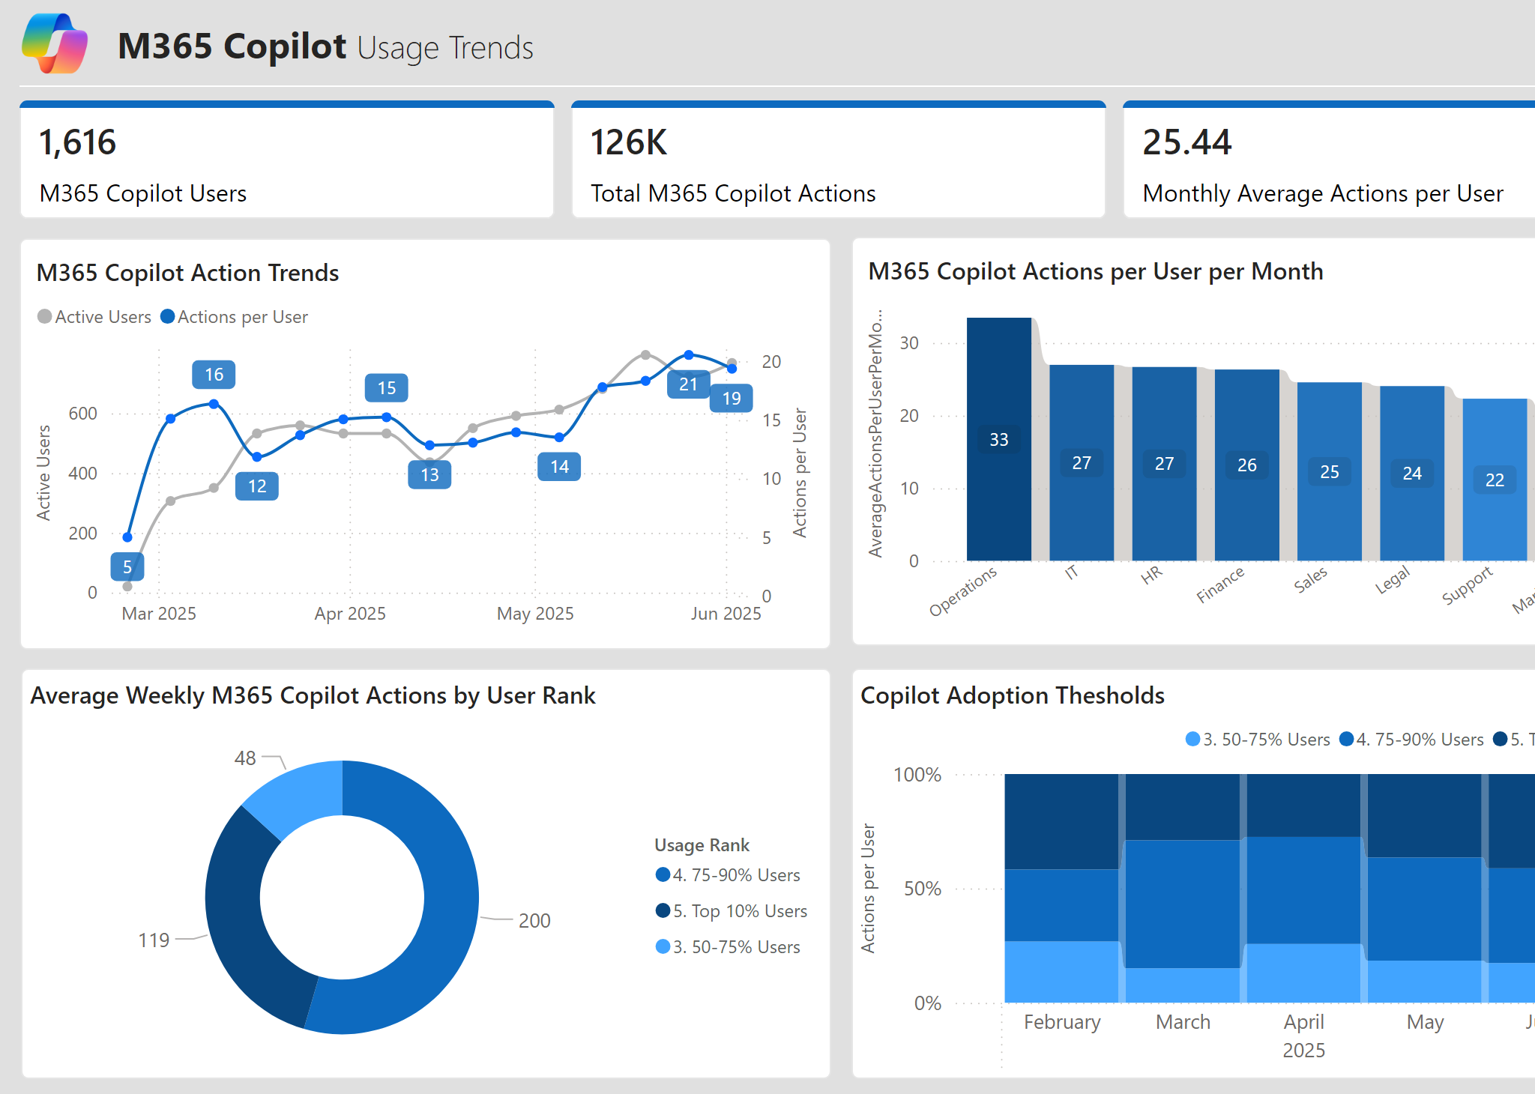
M365 Copilot: Depth Per User Validates the License
Example visual
What it means
Per-user intensity is higher once users are licensed—value deepens beyond casual chat.
Top user bands generate outsized weekly actions—your champions and pattern sources.

Slide 16
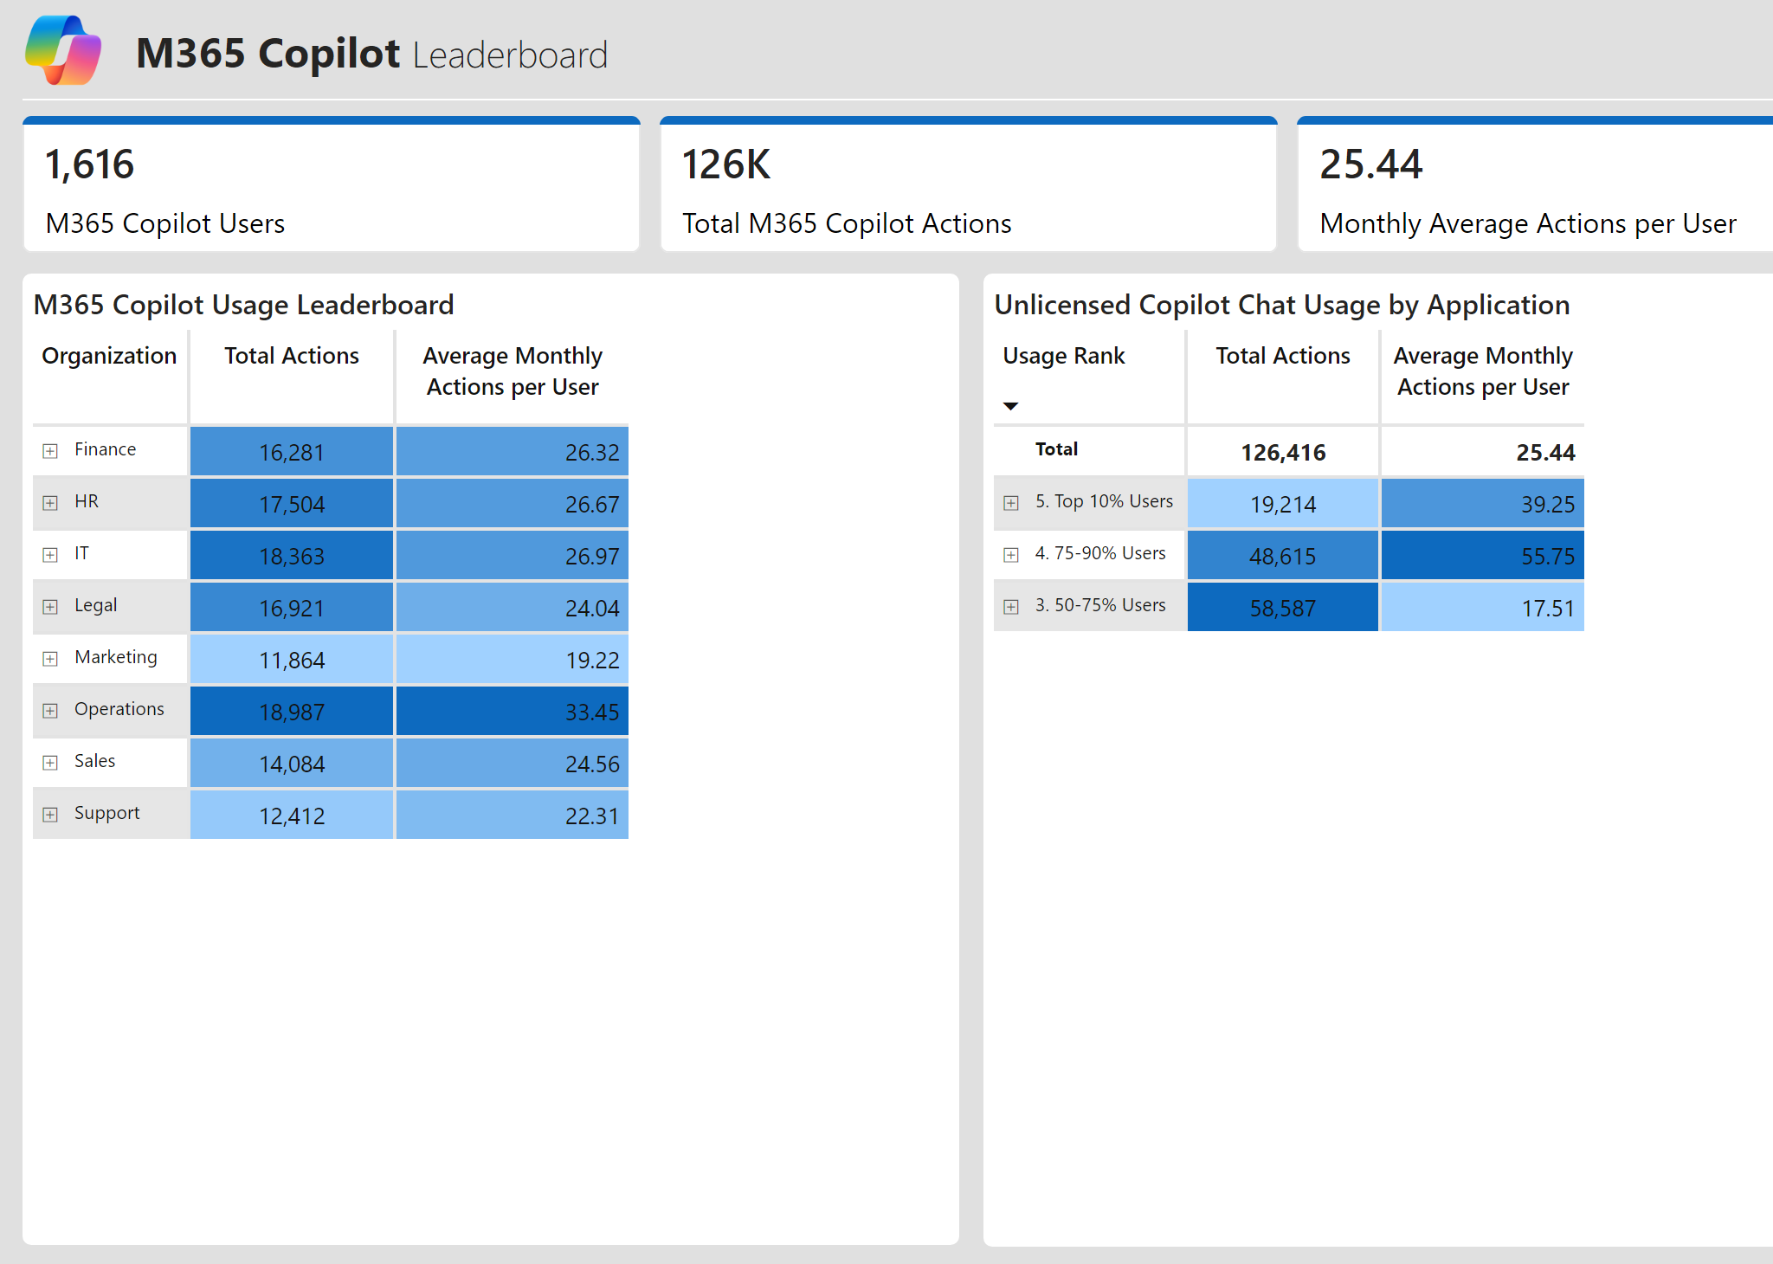
Uneven Distribution: The Vital Few Drive Most Copilot Actions
Example visual
What it means
Top quartiles—especially the top decile—account for a large share of activity (power-law adoption).
Function leaderboards help target communications and success stories precisely.

Slide 17
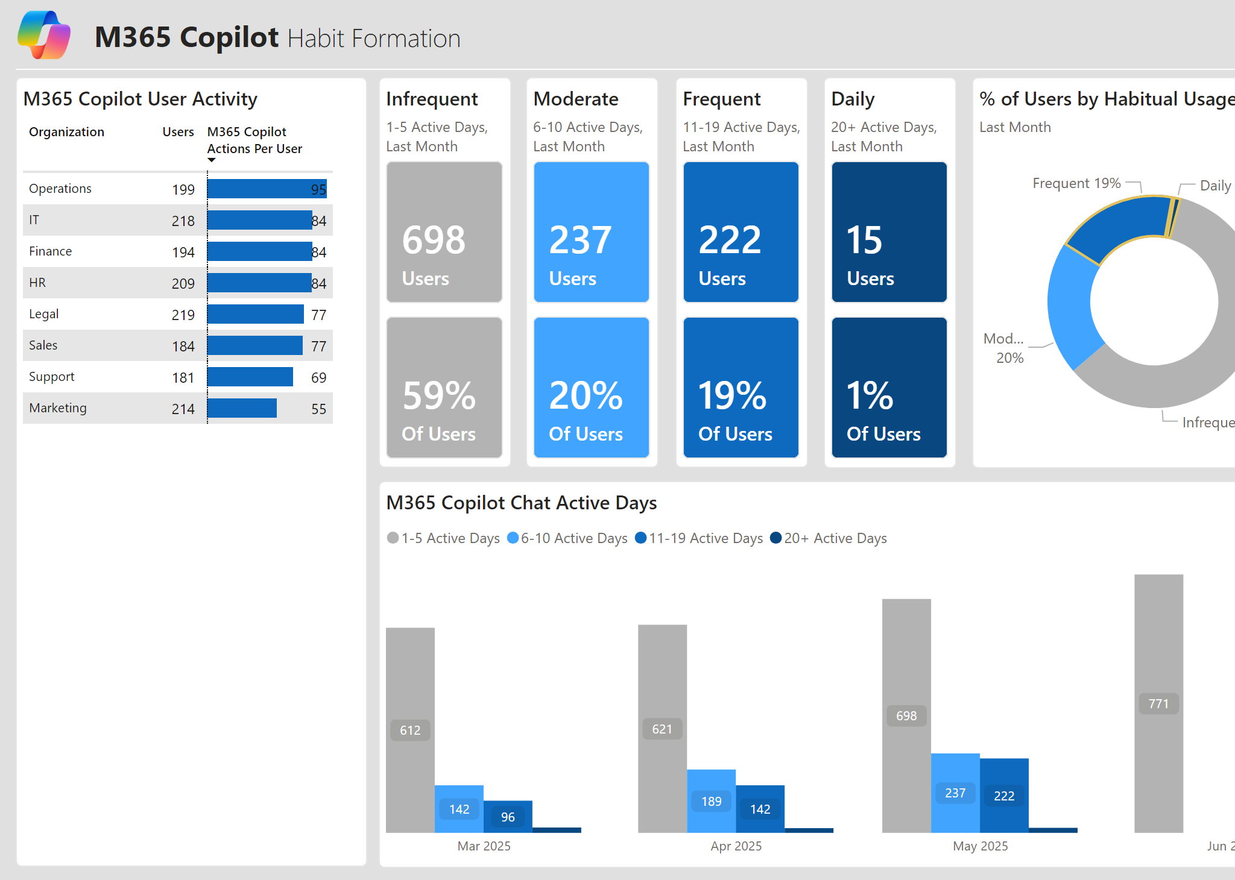
Copilot Habits: Good Start, Needs Daily Routines
Example visual
What it means
Majority of the licensed users are high frequency users already
Ops/IT/Finance/Legal have the highest proportion of frequent and daily active users

